Slide 1
26.02.2021 МП-11-20 Work. Job. Career.
Grammar: must, have to, can
will and might for predictions

Slide 2
WORK-(noun/verb)- general efforts and activities done to accomplish a goal. JOB–(noun/verb)- regular activity people do and receive money for. Profession/ occupation. CAREER – (noun) - total progression of a person’s professional life.
Complete the sentences with the words WORK, JOB or CAREER.
1. John is an emergency doctor. He has a very demanding ______________ .
2. She went to the shopping with some friends from ___________________ .
3. His father retired last year after a brilliant ____________________ .
4. Michael is very disappointed with his new ________________ because he discovered he has no _______________ prospects.
5. My supervisor is always very busy. He has got two _________________ .
6. Susan is busy at the moment. She has a lot of _______________ to do before 5 pm.
7. Where is your brother? – He went to a _____________ interview.
8. Jennifer is a lucky girl. She has just got a plum _____________ . I’m happy for her.
9. What he is doing is donkey ______________ . I wouldn’t like to do it.
10. You will ruin your _______________ if you keep behaving that way.

Slide 3
How people choose which job they want to do or which career they want to follow
Following the example of someone in their family or a friend
Celebrity role models
Doing what they’re good at or what they like

Slide 4
How people find jobs
Ask friends and family for vacancies
Go to a job centre
Answer job adverts (apply for a job)
Send your CV to different companies
Go to careers fair
A careers fair is an event where people can find out more about different companies and the jobs they offer. Employees are available to give information about their company and about career opportunities. These fairs are good for people looking for a job but they are also good for the companies as they can attract new people to work for them.
apply for a job – to present yourself formally, usually in writing, and say you want an employer to give you a job

Slide 5
Worries about finding a job Student’s Book, p. 50

Slide 6
will vs might
100% sure
I’ll make some really useful contacts.
I’ll find some kind of work
Maybe
I might get a job today!
I might not get my perfect job.

Slide 7
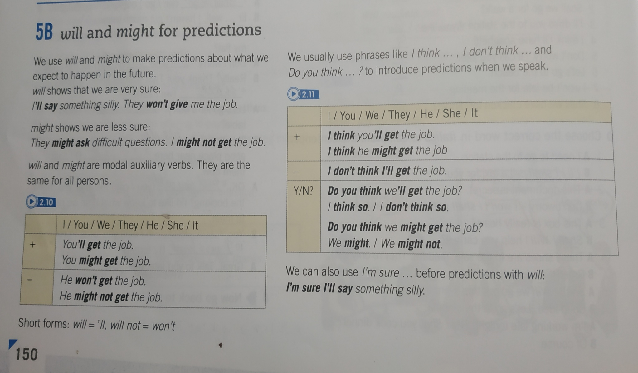

Slide 8
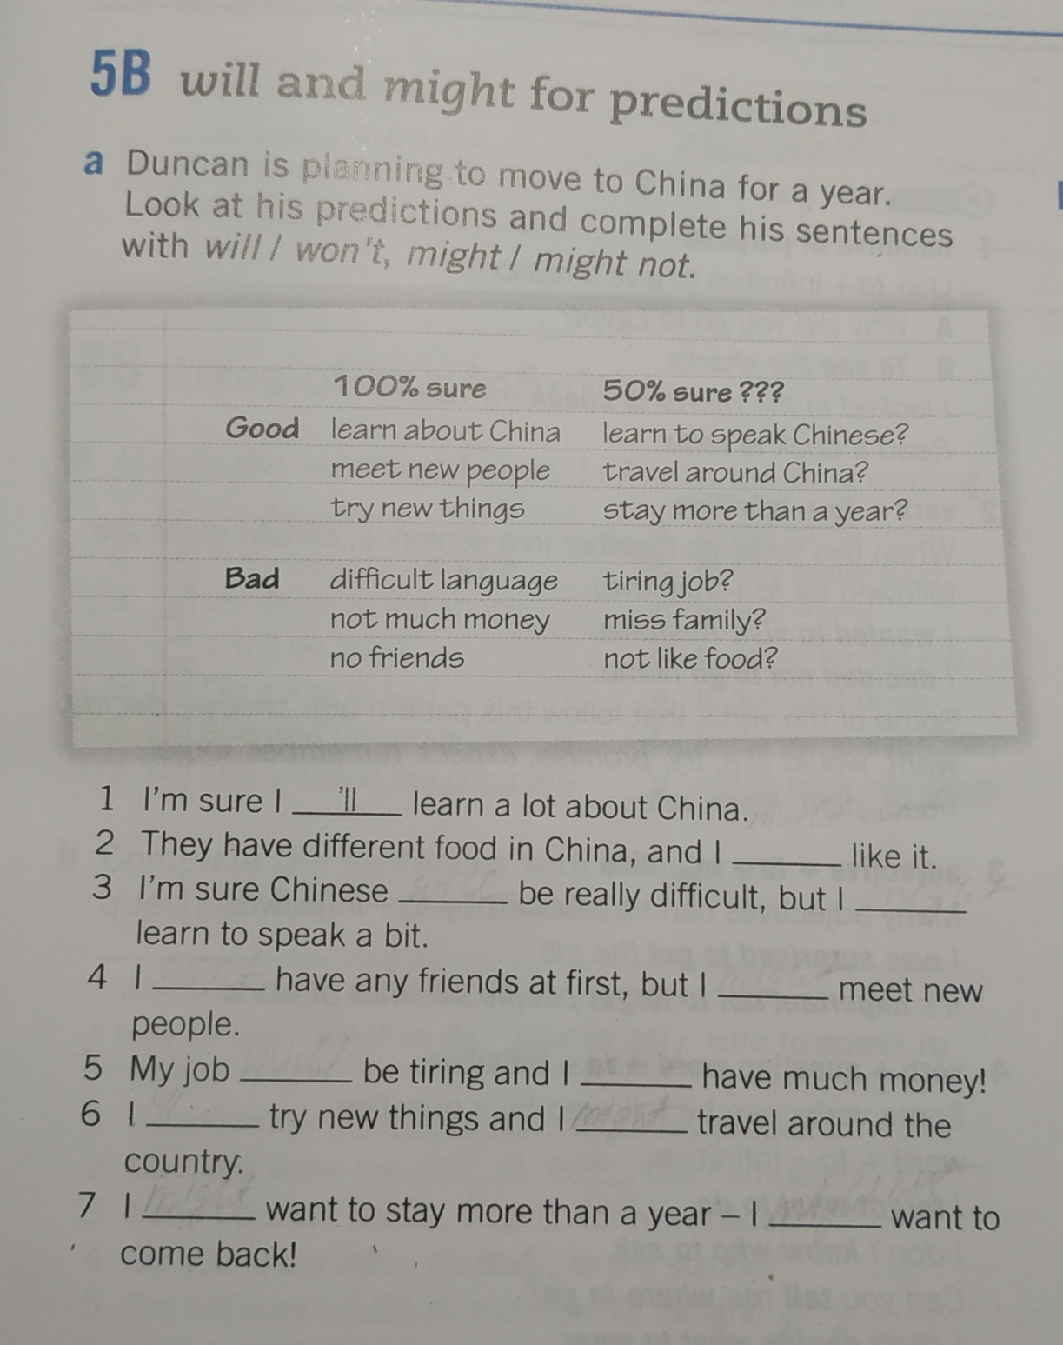

Slide 9
Say something you…
will do tonight
won’t do tomorrow
might do on the weekend
might make for Sunday dinner
won’t watch tonight
might not study on the weekend
will do in summer

Slide 10
What do you know about jobs?
Find, underline the jobs and read them:
okstudentgoteacherhdoctornonursekdentistnotpilotmcosmonautye
ssingerohdancertapolicemanw
eworkerbutpoetyetwriterheconomistwsailornopostmanohengineern
omodelufirefighter

Slide 11
Choose definitions to the following jobs:
1. A cook a) a person who cures teeth
2. A worker b) a person who writes books
3. A writer c) a person who fights with fire
4. A dentist d) a person who sings
5. A firefighter e) a person who cooks food
6. A captain f) a person who designs something
7. A sailor g) a person who controls the ship
8. A singer i) a person who works on a ship
9. A farmer j) a person who works at a plant
10. A designer k) a person who works on a farm

Slide 12
What is special in the following jobs? Match:
1. A cook a) can’t eat fattening food
2. A model b) has to know Maths and documents
3. A writer c) has to have very clean hands
4. A tourist guide d) has to wear a crash helmet
5. A teacher e) has to know all the elements of dance
6. A dancer f) has to know a lot of things
7. An accountant g) can work at home
8. A snowboarder h) has to know plants and animals
9. A farmer i) has to construct or design things
10. A designer j) has to know a lot of history

Slide 13
Quizlet Live
Get your phones ready!

Slide 14
Future career
Which jobs do you think might disappear
in the future?
shop assistant
postman
builder
Which jobs do you think there will be more of
in the future?
computer programmer
carer

Slide 15
What will happen because of these things?
Online shopping
Sending emails
Digital photos
3D printers
fewer jobs
Environmental problems
Living longer
Studying online
more jobs

Slide 16
Professional reading: types of computer systems (vocabulary)
voice recognition - розпізнавання голосу
versatile - універсальний
personal digital assistant - персональний цифровий асистент
hand-held - ручний
stylus - стилус
handwriting - почерк
reminder - нагадування
wireless - бездротовий
wearable computer - носимий мікрокомп'ютер
hands-free - гарнітура hands-free
voice mail - голосова пошта
mainframe - мейнфрейм, центральний пк
data - дані
simultaneous - одночасний
network - мережа
desktop PC - настільний пк
workstation - робоча станція
tower - баштовий (вертикальний)
корпус процесора
laptop - ноутбук
lightweight - легкий
portable - портативний
TFT screen - TFT-екран
touchpad - тачпад
battery pack - акумулятор
tablet – планшет
LCD screen - РК-екран
detached keyboard - від'єднана клавіатура

Slide 17
Complete the diagram while reading the text

Slide 18
Student’s Book, p. 151 Grammar 5B (b, c)
Work Book, p.29 5B
Professional Reading, Unit 3 p.14
Thank you and see you next week!

